Slide 1


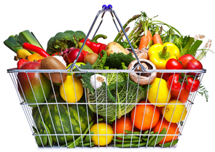
Cancer Prevention
Christi Kirk, RD
Oncology Dietitian
Banner MD Anderson Cancer Center

Slide 2

Prevention
“30% of cancers have a controllable nutrition component”
-American Institute for Cancer Research
Developed 10 recommendations for prevention

Slide 3
AICR Recommendations
#1- “Be as Lean as Possible without Becoming Underweight”
Work on building lean body mass

Slide 4
Why is Body Fat Important?
Research is clear:
“Carrying excess body fat-especially around the abdominal area-increases cancer risk”
-American Institute for Cancer Research

Slide 5

Obesity and Cancer
Body fat and hormones
Estrogen
Growth hormones
Increases risk of
Colon, esophageal, pancreatic, kidney, endometrial and breast

Slide 6
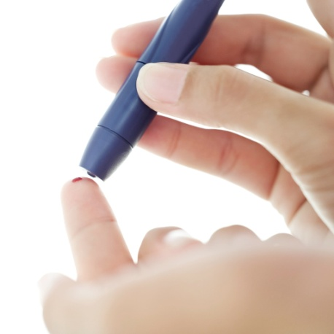
Obesity and Cancer
Having diabetes more than doubled the risk of pancreatic, liver, and endometrial cancers and also increased the risk of breast, bladder, and colorectal cancer.
-September 2012

Slide 7

Tools for a Healthy Weight
Discourage
Encourage
Fruits and vegetables
Whole grains
Natural fats
Sugary drinks
Calorie-dense foods
Alcohol
-AICR

Slide 8
AICR Recommendations
#2- “Be Physically Active at Least 30 minutes a day”
Walking, playing, swimming
Choose things that are fun!

Slide 9

AICR Recommendations
#3- “Avoid Sugary Drinks. Limit Consumption of Energy-Dense Foods (particularly processed foods high in added sugar, or low in fiber, or high in fat).”
Increase the risk of weight gain, overweight & obese

Slide 10
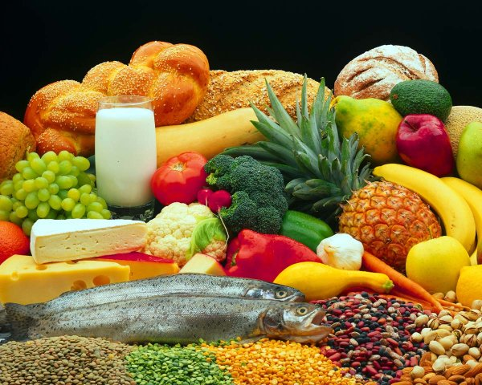
AICR Recommendations
#4- “Eat More of a Variety of Vegetables, Fruits, Whole Grains and Legumes Such as Beans.”

Slide 11
Cancer Prevention Foods
  Eat at least 5 servings of variety fruits and vegetables every day
  Fill about 2/3 your plate with fruits and vegetables and whole grains
  Variety is the key
Research suggests eating at least 5 servings vegetables and fruits per day can prevent at least 20% of all cancers (AICR)

Slide 12
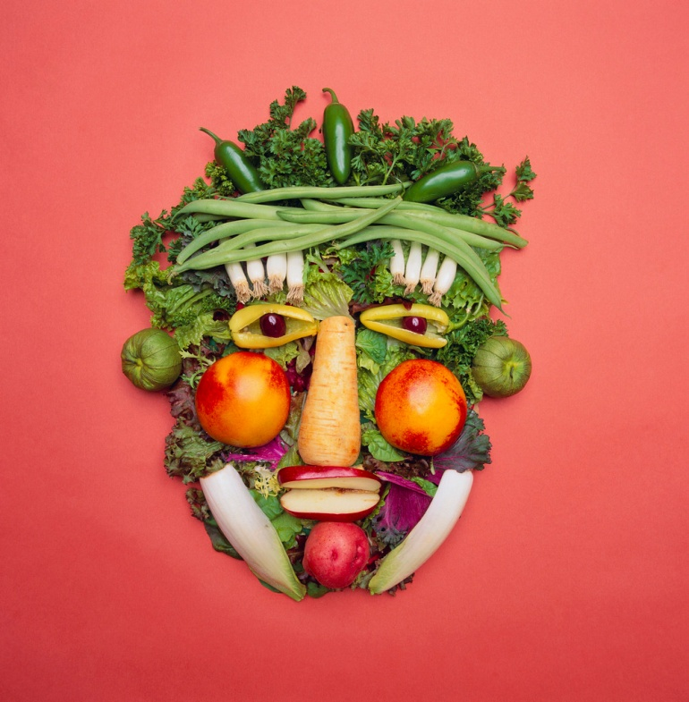
Fruits and Veggies
Cancer Fighting Components
Phytochemicals
Vitamins
Minerals
Fiber

Slide 13
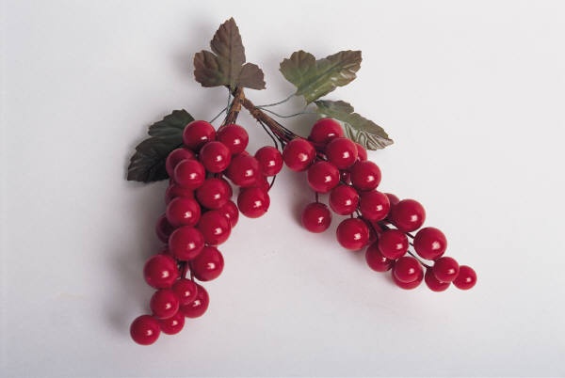
Cancer Prevention Foods
  Stock your refrigerator with a variety of different color fruits:
  Strawberries
  Blueberries
  Blackberries
  Raspberries
  Peaches
  Grapes
  Oranges
  Kiwi

Slide 14
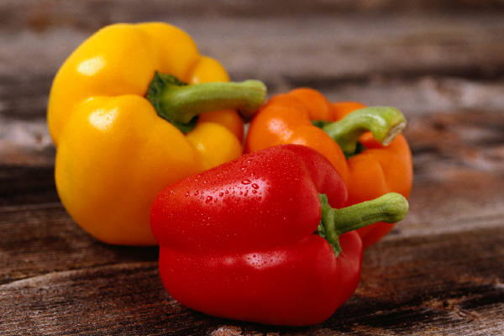
Cancer Prevention Foods
  Stock your refrigerator with a variety of different color vegetables:
  Carrots
  Spinach, kale
  Red peppers
  Green peppers
  Cabbage
  Tomatoes
  Cauliflower
  Onions

Slide 15
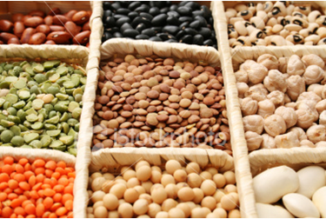
Try Something Different!
Brown Rice
Quinoa
Beans
Lentils
Nuts
Seeds
Whole wheat Pasta
Whole grain cereals
Kamut
Wheat Berries
Amaranth
Barley
Farro
Whole Wheat CousCous

Slide 16
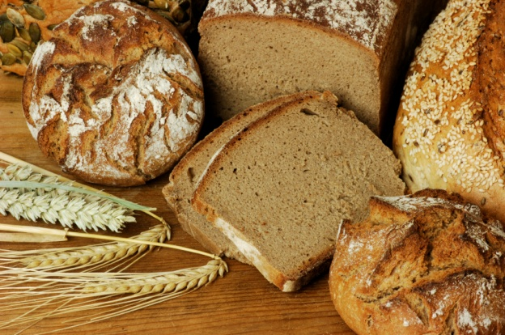
Fiber
  Carbohydrates that cannot be digested
    Not just for BM!
  >20 grams daily from food
  Found in whole grains, fruits, vegetables, beans and legumes

Slide 17
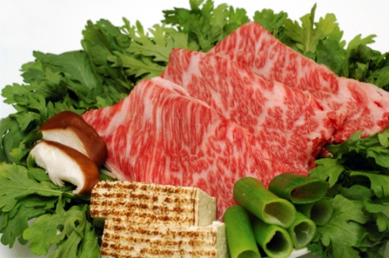
AICR Recommendations
#5- “Limit Consumption of Red Meats (such as beef, pork and lamb) and Avoid Processed Meats.”
Limit to 18 oz red meat per week
Limit charred and cooked at high temps

Slide 18

AICR Recommendations
Avoid Processed Meats altogether…instead of

Slide 19
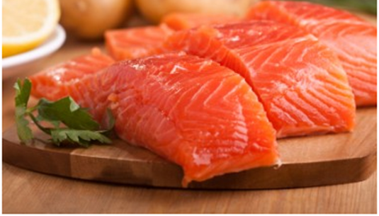
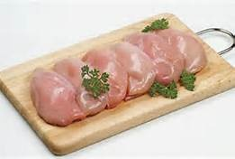
AICR Recommendations
Try:

Slide 20

AICR Recommendations
#6- “If Consumed at all, Limit Alcoholic Drinks to 2 for Men and 1 for Women.”
What about red wine?!?

Slide 21
AICR Recommendations
#7- “Limit Consumption of Salty Foods and Foods Processed with Salt (sodium).”
Use spices for flavor and
cancer fighting properties!

Slide 22
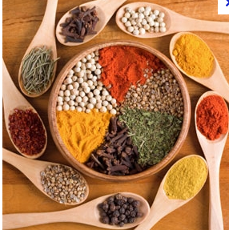
Cancer Prevention Foods
Herbs and Spices
NF-kB regulator(involved in immune and inflammatory processes)
Anti-inflammatory
Antibacterial
Antimicrobial
Nausea Reducer
Digestion aid
Appetite stimulant

Slide 23
Cancer Prevention Foods
Herbs and Spices
Turmeric
Ginger
Cilantro
Cayenne and Chilli flakes
Rosemary
Thyme
Cumin
Parsley
Mint

Slide 24
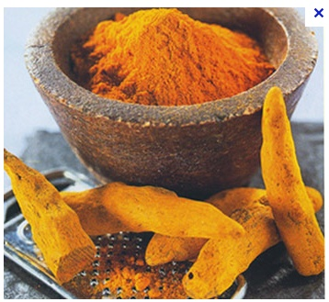
Cancer Prevention Foods
Can you guess this spice?
Turmeric
Anti-inflammatory
Appetite stimulant

Slide 25
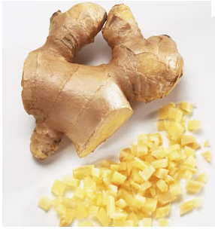
Cancer Prevention Foods
Can you guess this spice?
Ginger
Nausea Reducer
Anti- inflammatory
Anti-bacterial

Slide 26

AICR Recommendations
#8- “Don’t Use Supplements to Protect Against Cancer.”
Phytochemicals in a pill?

Slide 27
AICR Recommendations
#9- “It’s Best for Mothers to Breastfeed Exclusively for up to Six Months and Then Add Other Liquids and Foods.”
Good for Mom Good for baby

Slide 28
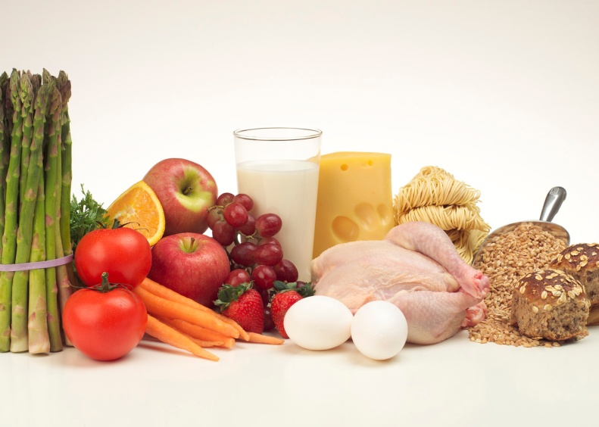
AICR Recommendations
#10- “After Treatment, Cancer Survivors Should Follow the Recommendations for Cancer Prevention.”

Slide 29
Cancer Fighting Foods
No single food or food component can protect you against cancer by itself
Evidence suggests that it is the synergy of compounds working together in the overall diet that offers the strongest cancer protection
Source: AICR

Slide 30
Daily Prevention Prescription Checklist
  5-7 servingsFruits/Vegetables including:
    1 Cruciferous
    1 Deep orange
    1 Citrus
    1 Dark green leafy
    1 Red
  1 serving Beans and Legumes
  1 serving Nuts and Seeds
  0 servings alcohol and sugary drinks

Slide 31
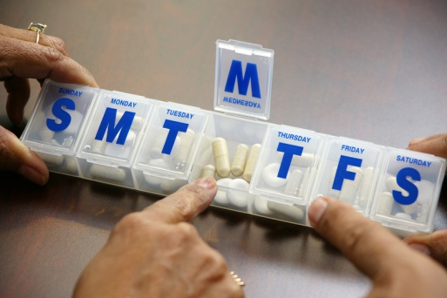
Weekly Prescription Checklist
  >1 serving Fish rich in Omega-3 including:
  salmon, light tuna, sardines and mackerel
  <18 oz. Red Meat including:
  beef, pork and lamb
  0 servings of Processed Meats including:
  lunchmeats, bacon and sausages

Slide 32

Thank You!
Any Questions?

Slide 33
References:
American Cancer Society
American Institute for Cancer Research
Oncology Nutrition – a dietetic practice group of the Academy of Nutrition and Dietetics
Foods to Fight Cancer – Essential Foods to Help Prevent Cancer
Banner MD Anderson Cancer Center: “Nutrition for people touched by cancer”
Nutrition Education for Cancer Prevention - Iowa State University
Redaniel MT, Jeffreys M, May MT, Ben-Shlomo Y, Martin RM. Associations of type 2 diabetes and diabetes treatment with breast cancer risk and mortality: a population-based cohort study among British women. [published online ahead of print Sept 13, 2012]. Cancer Causes Control. DOI: 10.1007/s10552-012-0057-0.
Giovannucci E, Harlan DM, Archer MC, et al. Diabetes and Cancer: A Consensus Report. CA Cancer J Clin. 2010;33:1674-1685.
Cancer Fighting Kitchen by Rebecca Katz
Nutrition in Clinical Practice;Oct. 2012

